Slide 1

SONG RECOMMENDATION SYSTEM

Slide 2
BUSINESS OBJECTIVE
This project aims to build a recommendation system to support a music app.

Slide 3
Dataset Description
'track_id' | id of the track
'artists' | name of the tracks’artist
'album_name' | name of the album
'track_name' | name of the track
'popularity' | popularity of the track
'duration_ms' | duration time of track in ms
'danceability' | danceability of track
'energy' | energy of track
'loudness' | loudness of track
'mode' | mode of track
'speechiness' | speechiness of the track
'acousticness' | acousticness of the track
'instrumentalness' | instrumentalness of the track
'liveness' | liveness of the track
'valence' | valence of the track
'tempo' | tempo of the track
'track_genre' | genre of the track

Slide 4
EDA (Exploratory Data Analysis)

Slide 5
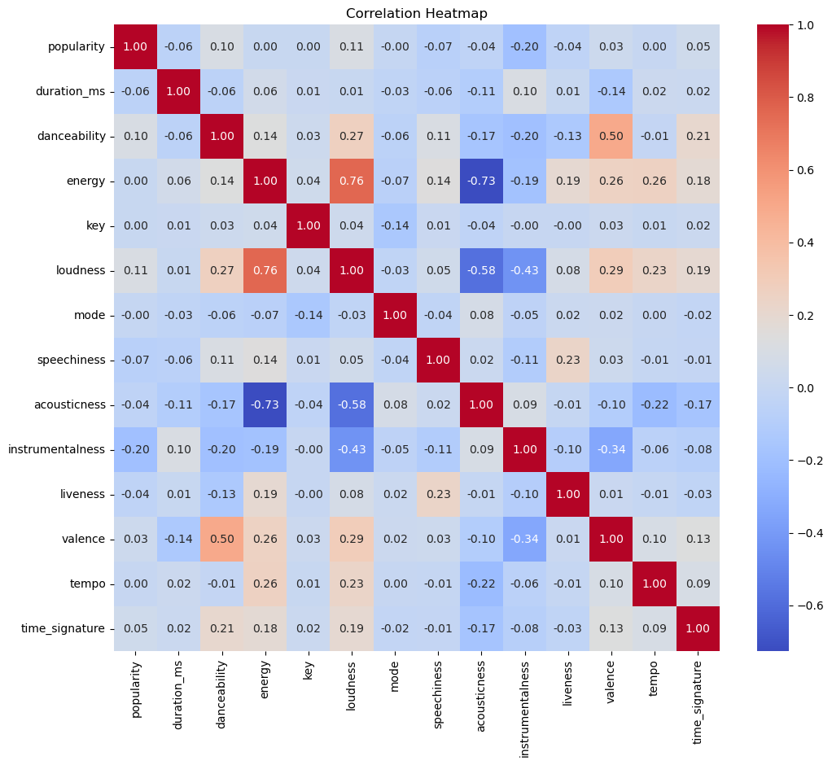
The correlation heatmap suggests that loudness and energy features have a good correlation 0.76).
The correlation heatmap also suggests that acousticness and energy features have a negative correlation (-0.73).

Slide 6
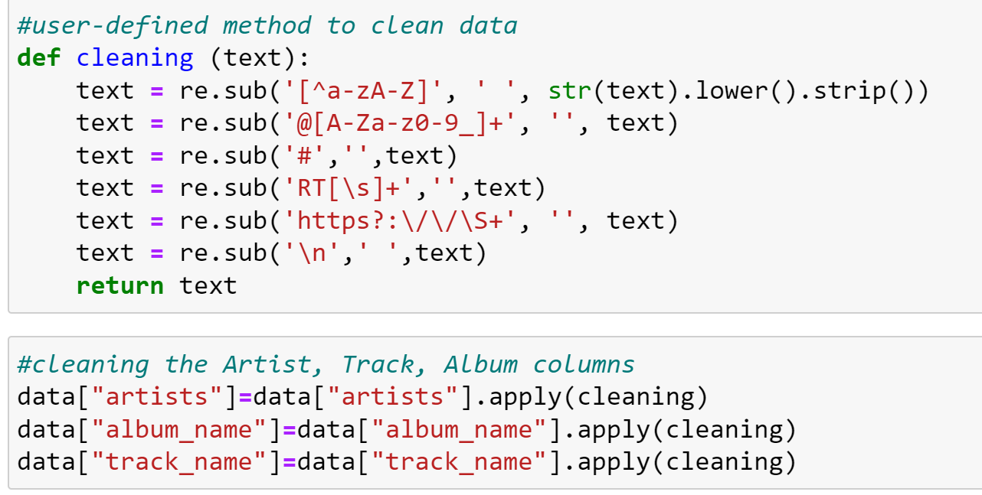
Devised a user-defined method called ‘cleaning’ to further clean our data from unwanted Special Characters, Symbols, and Spaces.

Slide 7
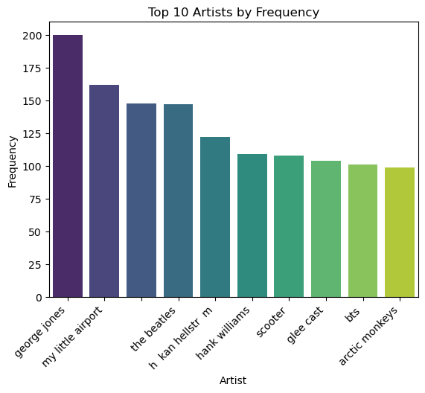
This bar plot displays the top 10 artists by frequency.

Slide 8
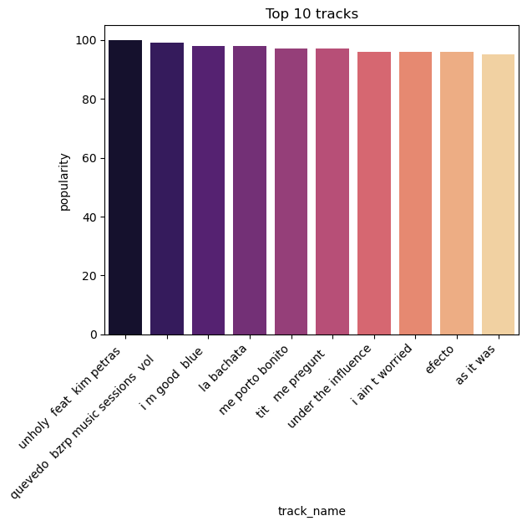
As shown, this bar plot displays the top 10 tracks by popularity.

Slide 9
These are the ideal conditions of musical attributes that a relaxing/ yoga/ peaceful song must satisfy.
Most of the tracks in our dataset also qualify for this criteria.
Energy:
Yoga: 0.6 - 0.8
Meditation: 0.3 - 0.5
Loudness:
Yoga: -15 dB to -10 dB
Meditation: -25 dB to -20 dB
Speechiness:
Yoga: 0 - 0.4
Meditation: 0 - 0.2
Acousticness:
Yoga: 0.4 - 0.8
Meditation: 0.7 - 0.9
Instrumentalness:
Yoga: 0.5 - 0.8
Meditation: 0.8 - 0.9
Liveness:
Yoga: 0.2 - 0.6
Meditation: 0.1 - 0.4
Valence:
Yoga: 0.5 - 0.8
Meditation: 0.3 - 0.6
Tempo:
Yoga: 80 - 120 BPM
Meditation: 60 - 80 BPM
Liveliness:
Yoga: 0.4 - 0.7
Meditation: 0.2 - 0.5

Slide 10
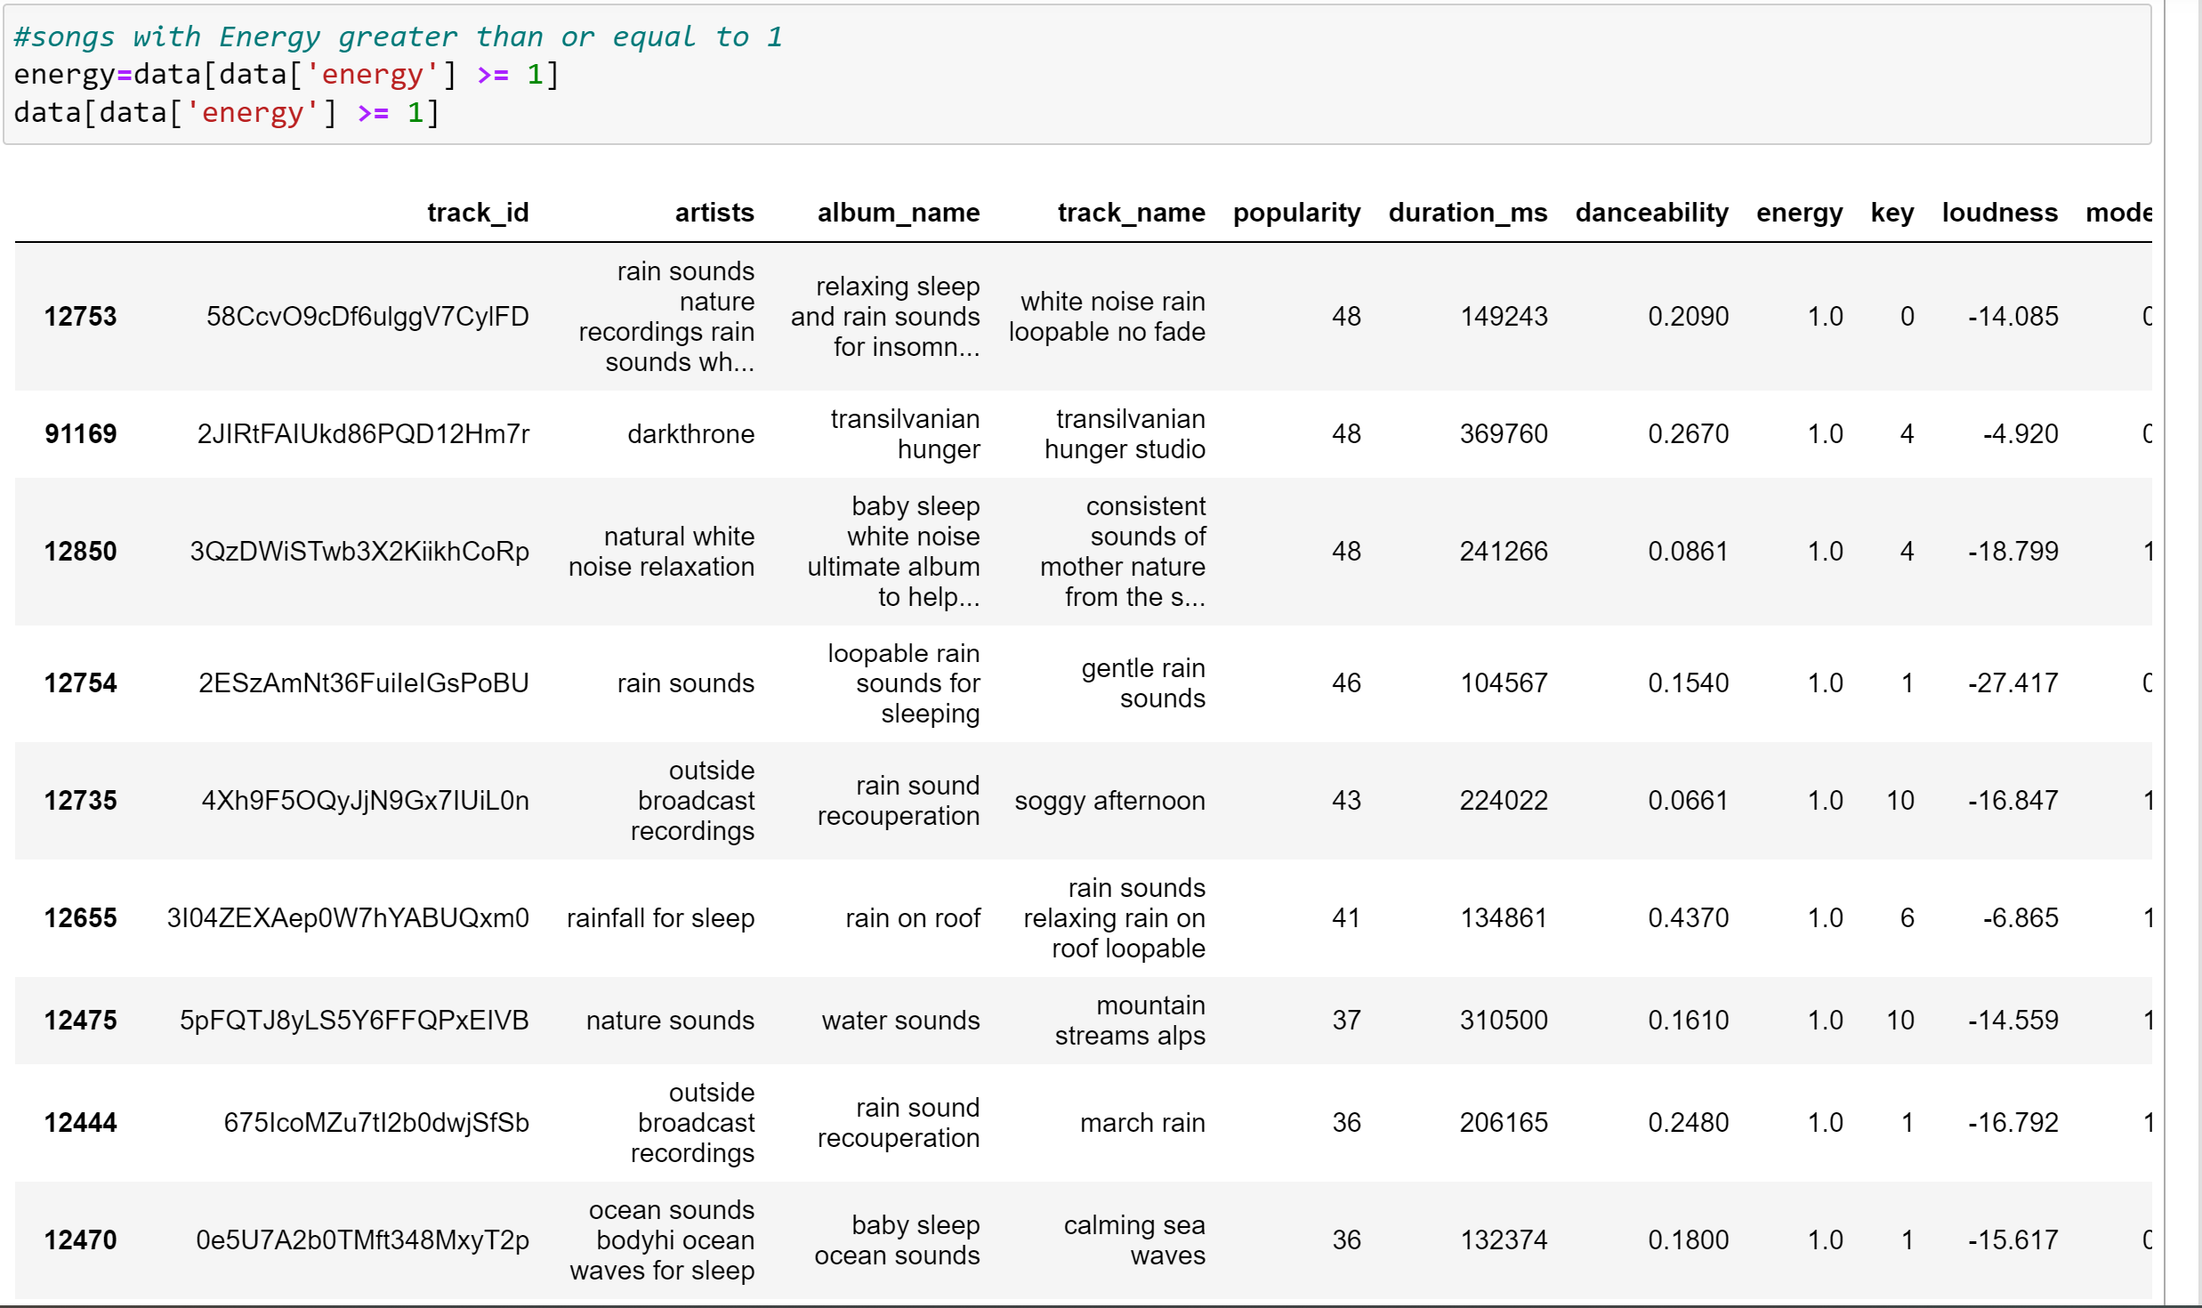
The tracks which have energy levels greater than or equal to 1 are displayed.

Slide 11
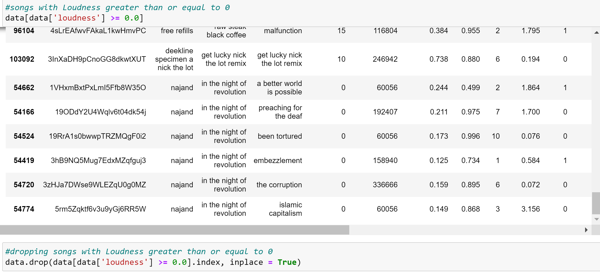
The tracks which have loudness greater than or equal to 0 are displayed.
These tracks are then dropped.

Slide 12
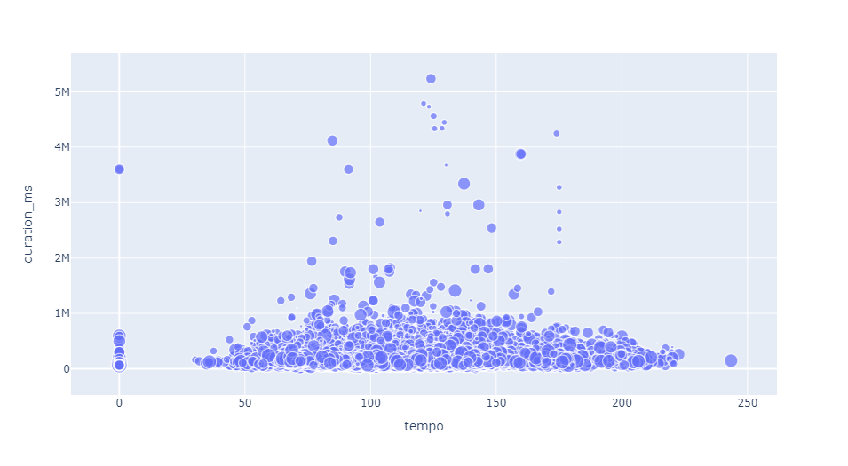
Duration VS Tempo
This plot shows the spread of tempo against the duration time of the tracks.

Slide 13
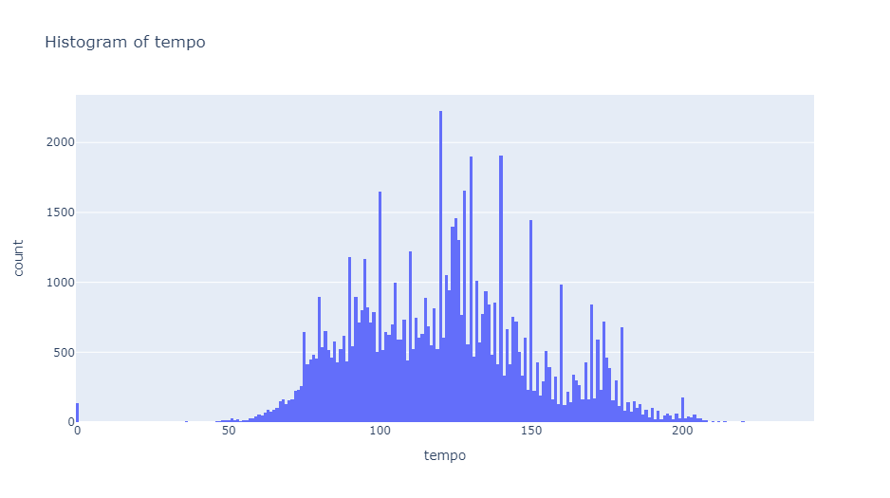
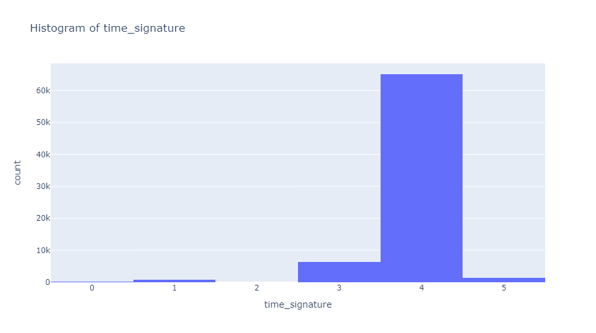
Count of Tempo
We can infer from this graph that most of the tracks have a tempo of more than 150.
Avg. Time Signature
Most of the tracks have an avg. time signature value of 4 min

Slide 14
MODEL BUILDING

Slide 15
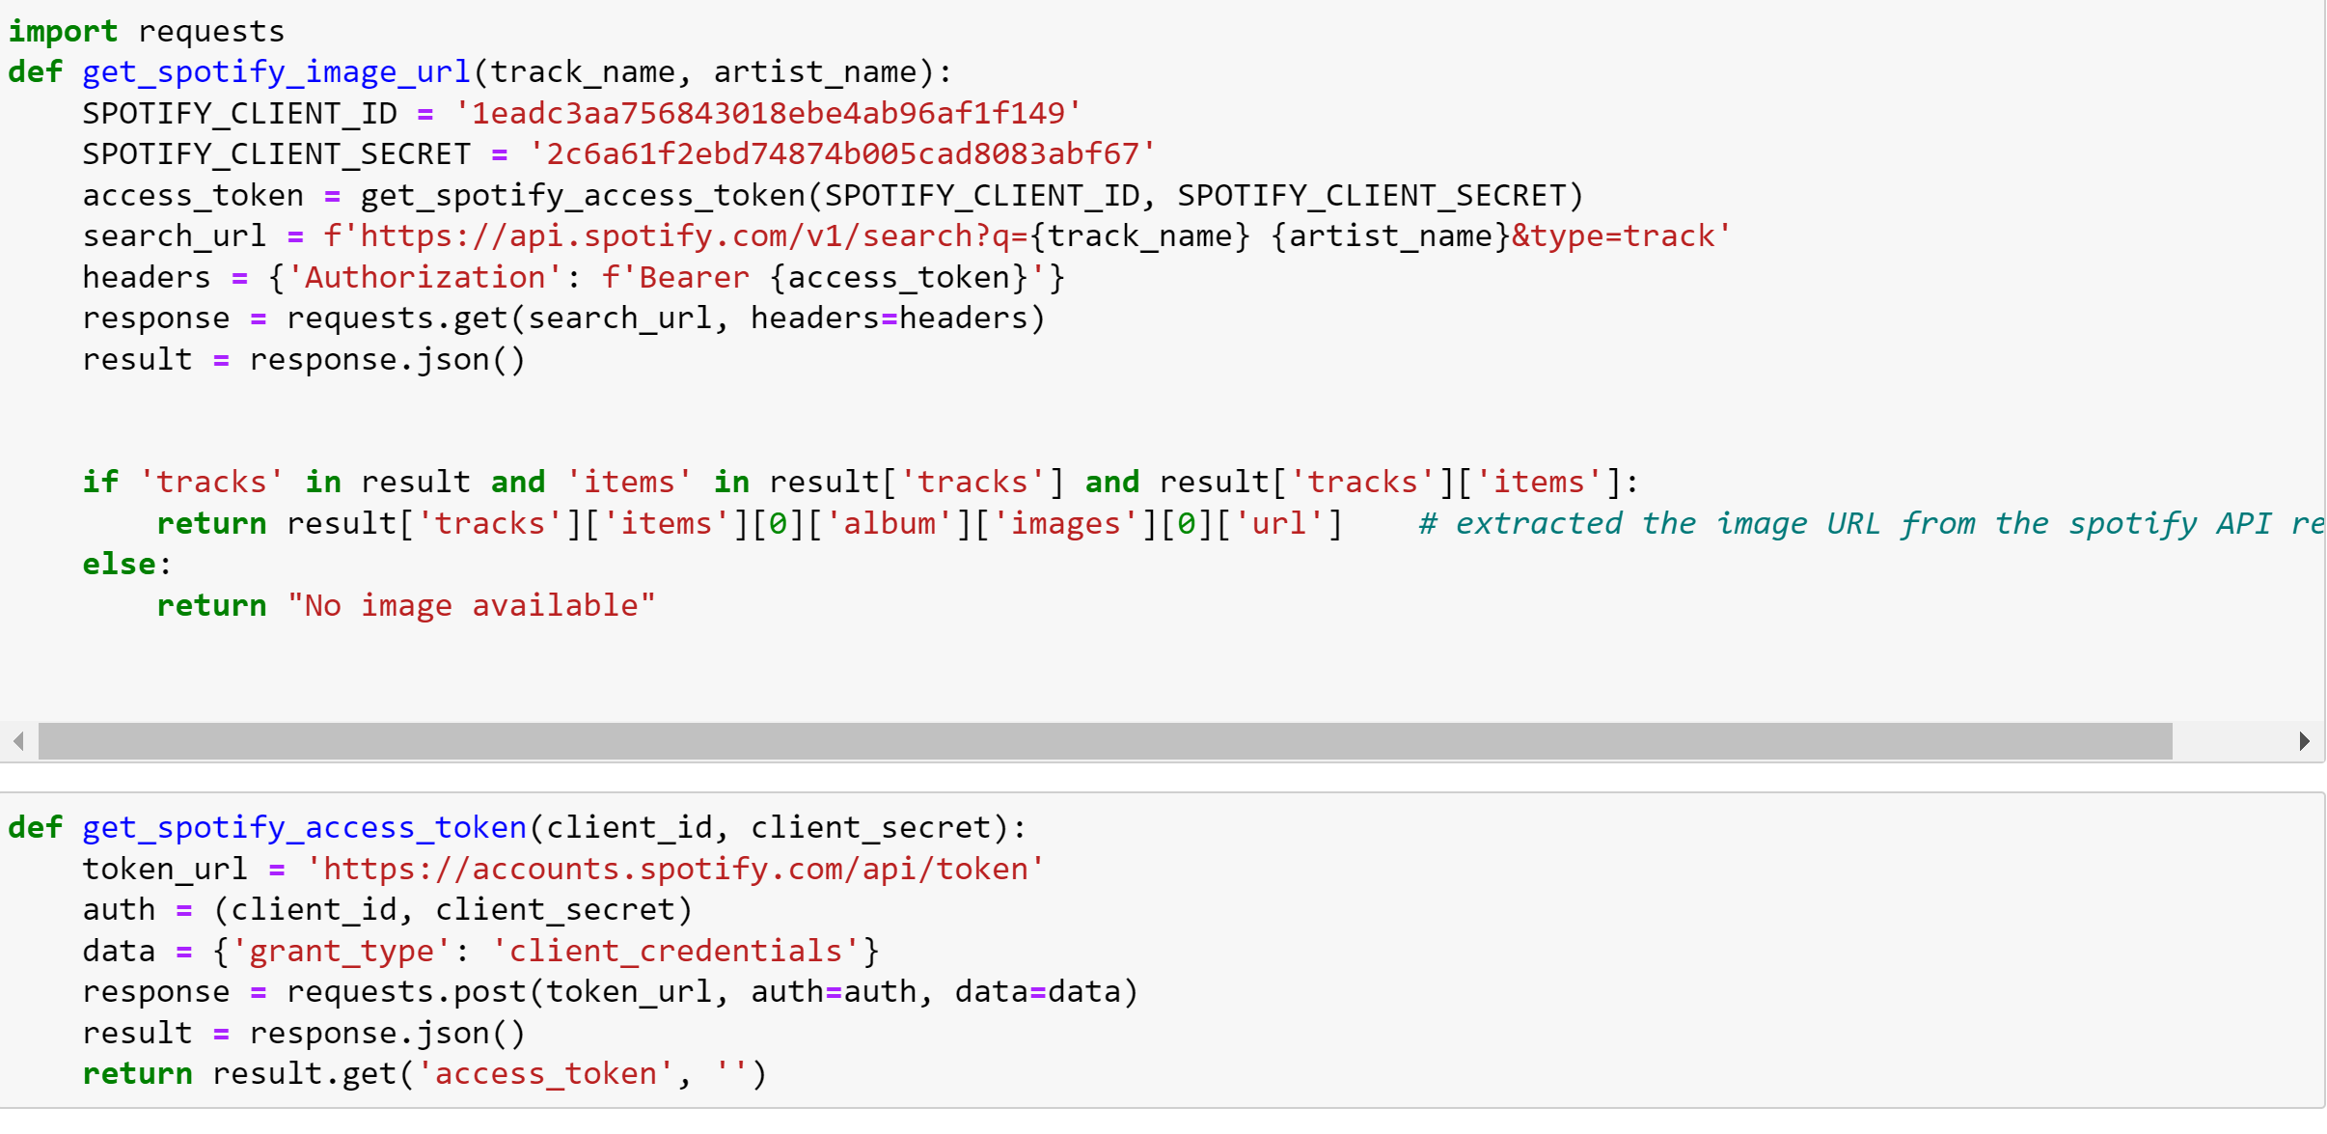
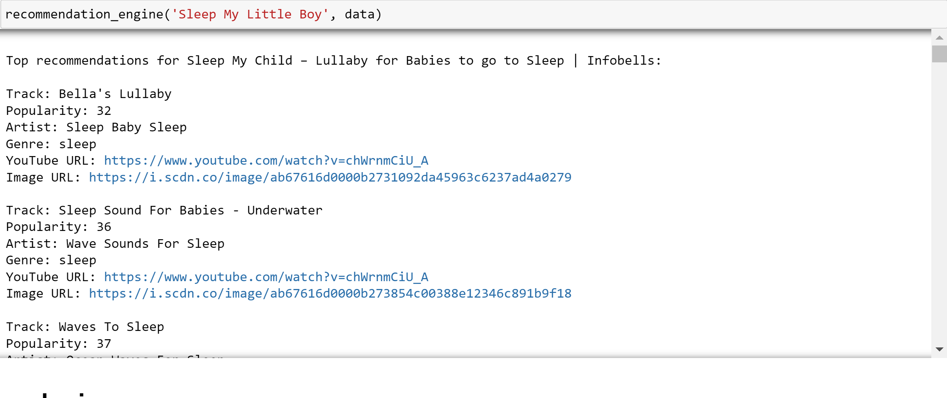
Generating Images for the URL's using Spotify API
These are the links for the Spotify API
https://developer.spotify.com/
https://developer.spotify.com/documentation/web-api

Slide 16
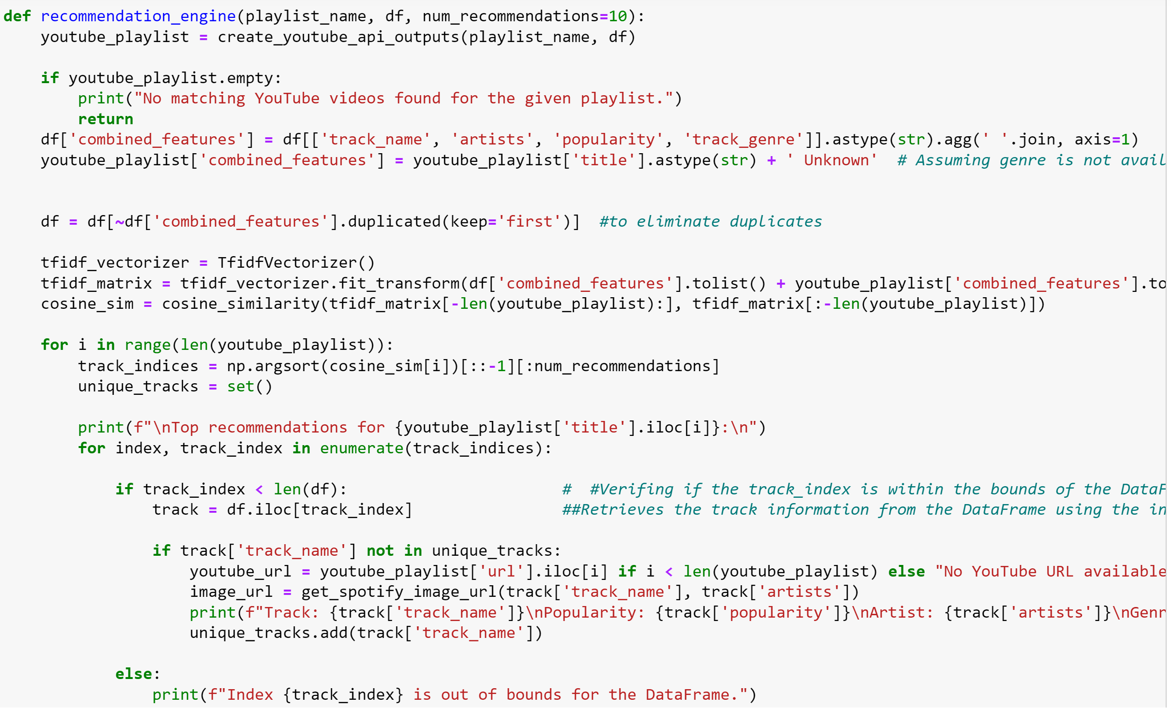
This function essentially uses TF-IDF and cosine similarity to recommend tracks from the main DataFrame based on the YouTube playlist. The recommendations are printed with relevant details, and efforts are made to handle boundary cases and avoid duplicate recommendations.

Slide 17
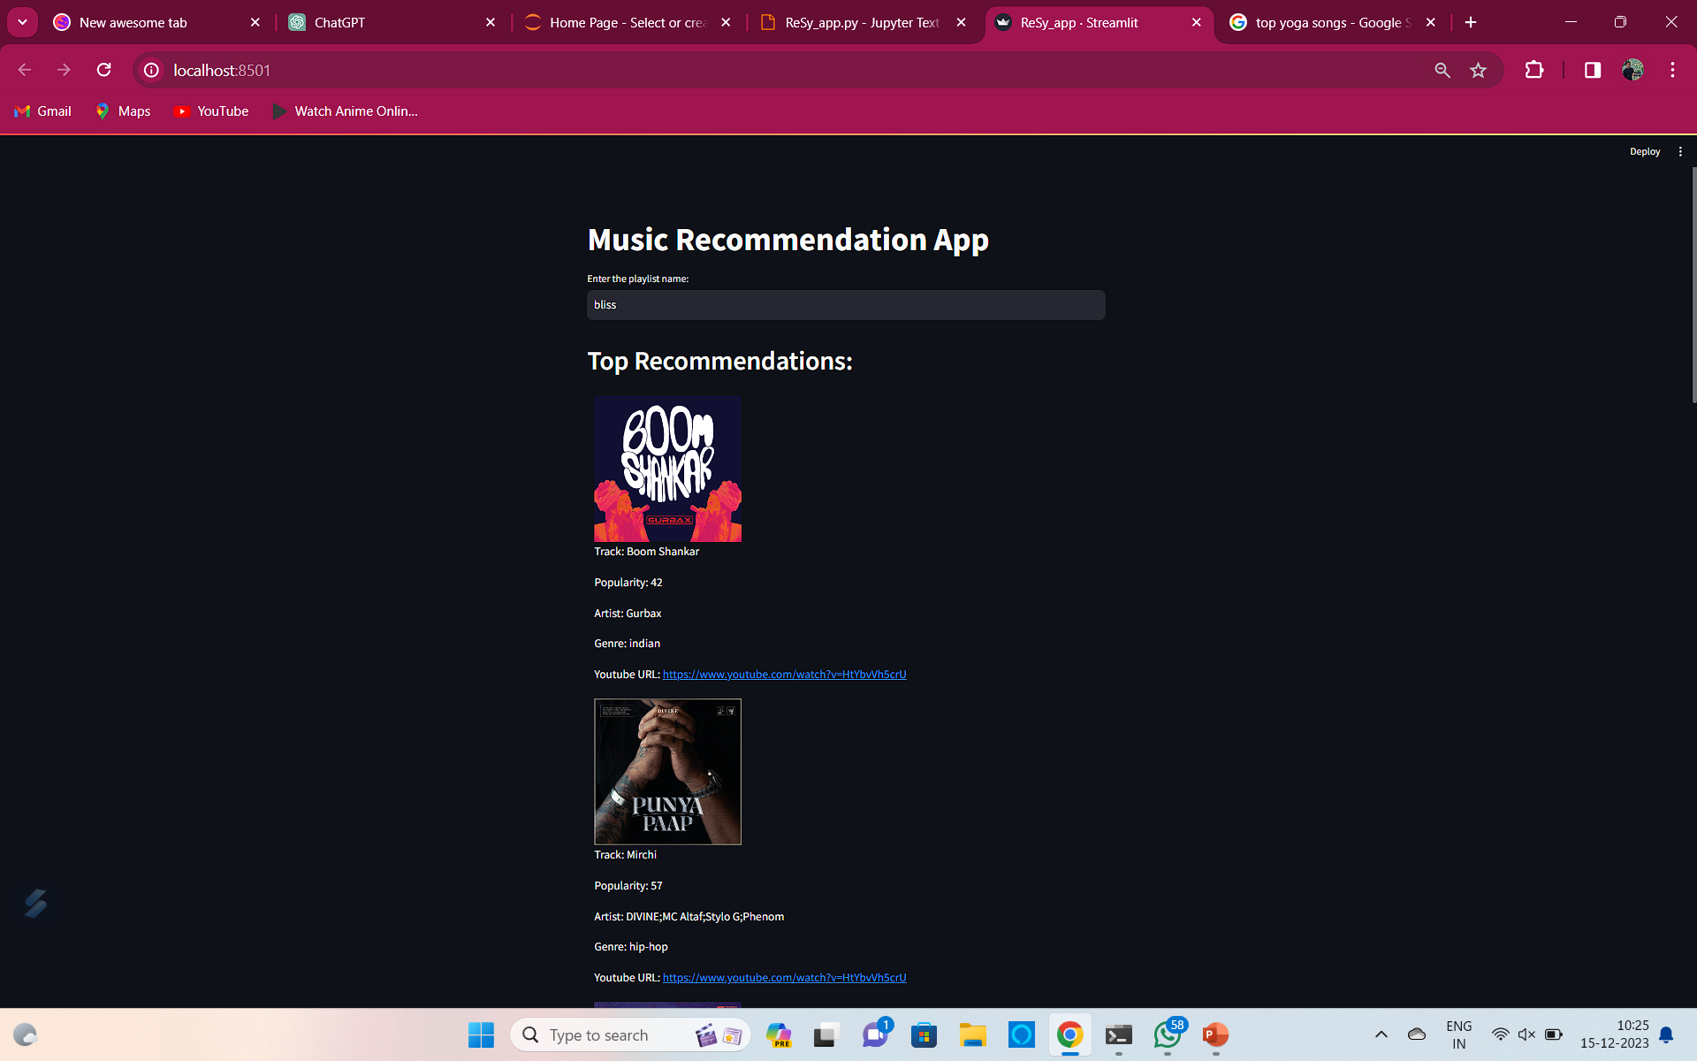
MODEL DEPLOYMENT
Used STREAMLIT to deploy the model

Slide 18
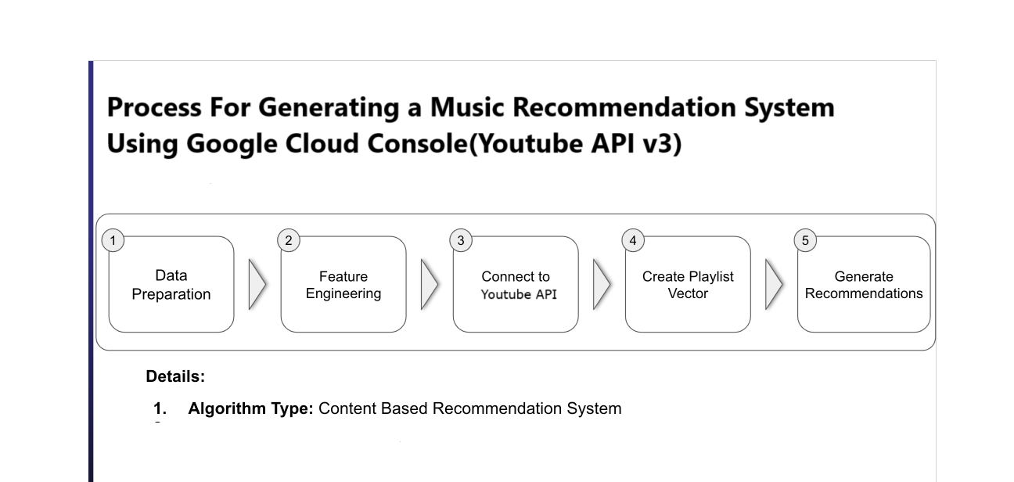
Overview

